Slide 1
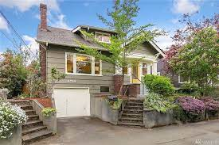

Home Price Prediction Model
By
Garrett J.A. Hass
Data Science Final Capstone 9/29/2022

Slide 2


Problem Statement
Need to predict the price of a home to assist clients
Competitive advantage over other companies
What traits have
a high correlation with the price?
Can we predict the price accurately?

Slide 3









Stakeholders
Realtors
Buyers
Sellers
Potential Clients of Real Estate Companies
NAR
Zillow
Redfin
Investors
Housing Market Companies
HOAs
Mortgage Companies
Banks
Real Estate Companies
Appraisers

Slide 4
Solution to our Problem
Create a model to predict the price of a home
Finding variables that are correlated with price
Identifying unique outliers
Using four types of Models:
Linear Regression
Ridge Regression
Random Forest
XGB Regression

Slide 5
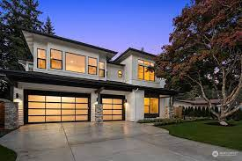
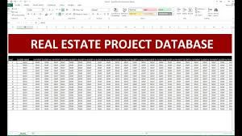
Dataset
Kaggle compilation of Real Estate transactions
https://www.kaggle.com/datasets/shree1992/housedata?select=data.csv
https://www.kaggle.com/datasets/shree1992/housedata?select=data.csv
Seattle Metro Area
Data is from May 1st, 2014 to July 9th
Is there enough data to predict the price?

Slide 6

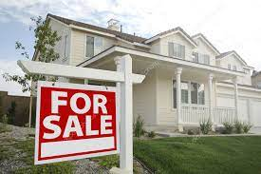
Data Wrangling
Started with 17 columns and 4,600 rows
Dropped certain rows
Added three columns
Only two NaN values
Dummy variables for Condition & View
Ended up with 25 columns and 4,600 rows
Target Variable is Price

Slide 7
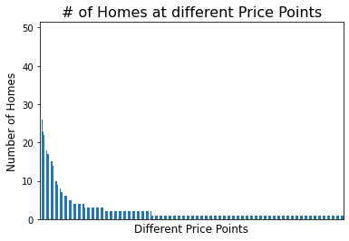
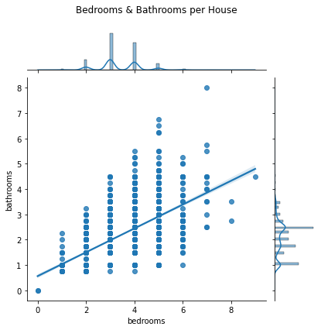
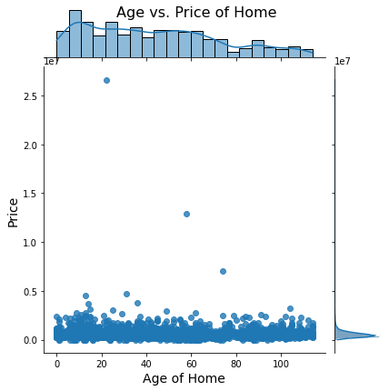
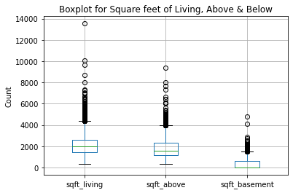
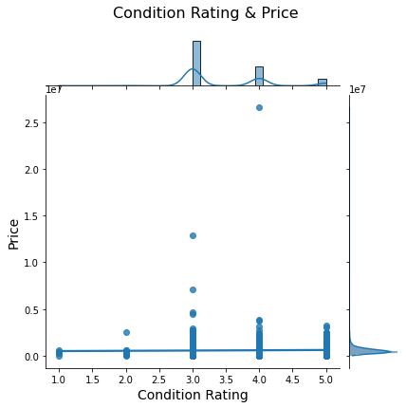
Exploratory Data Analysis

Slide 8
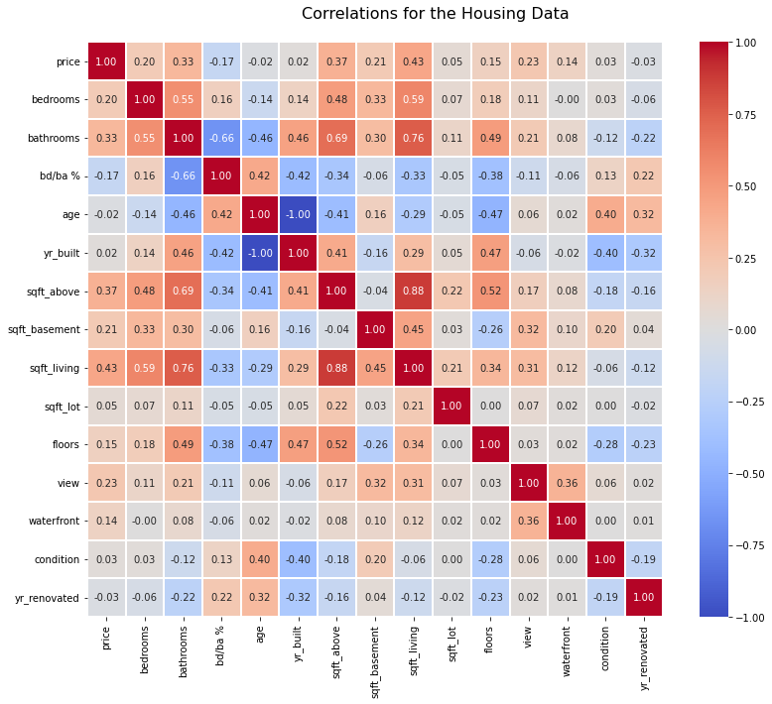

Slide 9
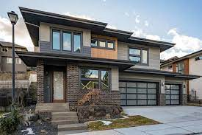
Many outliers for square feet of living, above and below.
Most homes had a condition rating of 3-5.
As # of bedrooms increased so did the # of bathrooms.
Most of the homes had three to six bedrooms.
Price and square feet of living space, positive correlation.
One outlier home was under 2,000 sq ft and $10 million.
EDA Key Findings

Slide 10
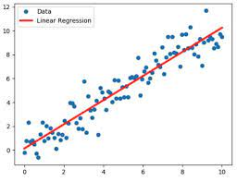
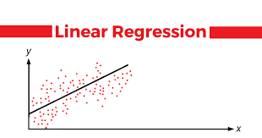
Regression Model Selection
Linear Regression
Ridge Regression
Random Forest Regression Model
XGB Regression
Best Model was:
Linear Regression
- Typically best model for predicting price of real estate
- R2 score of .47
- MAE of 164,817.45

Slide 11
Model Results Analysis
a. Linear Regression
1) R2 = .4696
2) MSE = 61,734,606,846.02
3) RMSE = 248,464.50
4) MAE = 164,817.45
b. Ridge Regression
R2 = .467
MSE = 61,974,982,112.41
RMSE = 248,947.74
MAE = 165,587.70
c. Random Forest Regression
R2 = .395
MSE = 70,352,537,281.89
RMSE = 248,947.74
MAE = 140,215.58
d. XGB Regression
R2 = .303
MSE = 81,126,092,073.28
RMSE = 248,947.74
MAE = 145,701.31

Slide 12
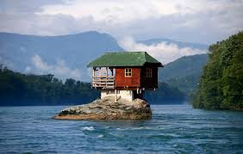
Recommendations
Need more data
Could improve R2, MAE, etc. scores
More X variables
Information to Clients
Share with them our EDA findings
Improve buyer morale
Help sellers fix issues with their house
3) Unique Houses for Clients
Our model could be a better comp than zillow
Helping buyers if the house they like is over or under priced
Find similar houses with certain traits

Slide 13


Whats next?
- Collect more data
- More variables for our model
- Improve our R2 score
- Run models on different variables

